Slide 1
Let’s build a (biased) RAG
February 13, 2026 Zoryana Paliy

Slide 2

qr.codes/2XQevB

Slide 3
Agenda
Chunk
Embed
Store / Retrieve
Create prompts with context
Talk to LLMs
Compare results

Slide 4
Requirements
nltk - Natural Language Toolkit
fastembed - free library of embedding models
tiktoken - BytePairEncoding tokenizer for OpenAI
openai - library for OpenAI API
google-genai - library for Gemini API
requests - talk to a free LLM (mlvoca, tinyllama)

Slide 5
Chunk

Slide 6
Text chunking
Why do we need chunks?
What is tokenization?
What is a token?
Why do we need tokenization?
Why do we need overlaps?
Optimal chunk sizes.

Slide 7
Why do we need chunks?
LLMs:
Have a limited context window
Process text in tokens
Work best with focused, relevant input.
Chunking allows us to:
Store documents efficiently
Embed smaller semantic units
Retrieve only relevant parts
Reduce cost and noise
LLMs cannot read entire
documents at once.
Documents need to be split into smaller, meaningful pieces called chunks.

Slide 8
What is tokenization?
LLMs do not process text as sentences or words.
They process it as tokens.
Example:
"I love linguistics." ->
["I", " love", " lingu", "istics", "."]
Tokenization differs across tokenizers (different tokens and different amount of tokens).
Splitting text into smaller computational units.
! Not meaningful units, but computational units.

Slide 9
What is a token?
Compare:
In linguistics the smallest meaningful unit is a morpheme:
unhappiness
un- (negation)
happy (root)
-ness (noun forming)
Tokenization in LLMs is not morphological.
It is statistical and compression-based.
unhappiness
["un", "happi", "ness"]
["unh", "app", "iness"]
Token is a smallest
computational unit
the model processes.
Tokenizer - OpenAI API

Slide 10
Why do we need tokenization?
Embeddings have token limits.
LLMs have context window limits.
Pricing is based on tokens.
Overlaps must be measured in tokens to be consistent.
When chunking on words or sentences, we would be guessing the amount of tokens.
We need token-based chunking because LLMs “think” in tokens,
not words or sentences.

Slide 11
Why do we need overlaps?
Without overlap:
Chunk 1: The suspect denied being
Chunk 2: present at the scene.
With overlap:
Chunk 1: The suspect denied being present
Chunk 2: being present at the scene
Preserve semantic continuity
Prevent information loss at borders
Improve retrieval accuracy
Reduce hallucination risk.
Typical overlap:
10–20% of chunk size
Chunks split text into separate pieces.
But meaning often crosses boundaries.

Slide 12
Optimal chunk sizes
Depends on:
Document type
Retrieval goal
Model context window
Cost constraints
Why not too small?
Too fragmented
Loss of context
Retrieval becomes noisy
Why not too large?
Irrelevant information included
More expensive
Reduced retrieval precision
There is no universal “perfect” size.
| Use case | Chunk size | —--------------------- —-------------------
| Short factual text | 200–400 tokens |
| Analytical text | 400–800 tokens |
| Narrative text | 500–1000 tokens |
We’ll use 500 tokens, 100 tokens overlap.

Slide 13
Chunking is a trade-off between
context preservation and retrieval precision.

Slide 14
Embed. Store. Retrieve

Slide 15
Text embeddings
What are embeddings?
Why do we need embeddings?
How do we store embeddings?
What is vector search?

Slide 16
What are embeddings?
"The moon is round"
→ [0.012, -0.887, 0.331, ..., 0.004]
Modern embedding model dimensions commonly range from 256 to 4096, with 768 and 1536 being typical for representing semantic information efficiently.
Higher dimensions = capture more nuance
Lower dimensions = fast and need less storage
Key idea of embeddings: Texts with similar meaning → vectors close together in space.
Embeddings are numerical vector
representations of text that capture semantic meaning.

Slide 17
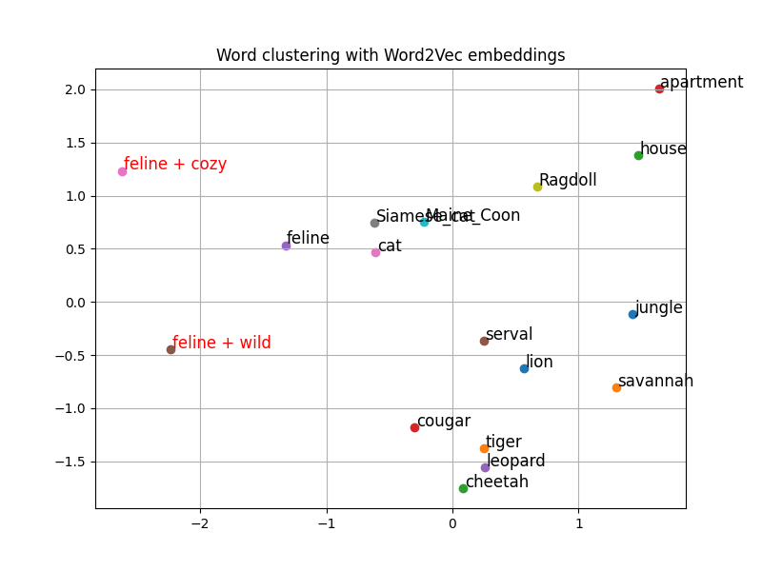
A simple example from the last decade
Word2Vec (2013)
Predict word context using a shallow neural network.
KEY IDEA Words that appear in similar contexts have similar meaning.
If “cat” and “dog” appear near words like “pet,” “food,” “cute,” they’ll end up with similar embeddings.

Slide 18
Why do we need embeddings?
Computers cannot compare meaning directly, but they can compare numbers.
Without embeddings:
We can only search by keywords.
“automobile” ≠ “car”
“error analysis” ≠ “mistake examination”
With embeddings:
We search by semantic similarity, not exact wording.
With embeddings
meaning
becomes geometry.

Slide 19
How do we store embeddings?
We store:
The text chunk
The embedding vector
In:
SQLite (as BLOB or JSON) - veeery basic
PostgreSQL + pgvector (extension for vector search)
LanceDB - multimodal vector database
FAISS (Facebook AI Similarity Search) - open-source library for similarity search
etc.
We store embedding vectors in a database that allows fast similarity search.

Slide 20
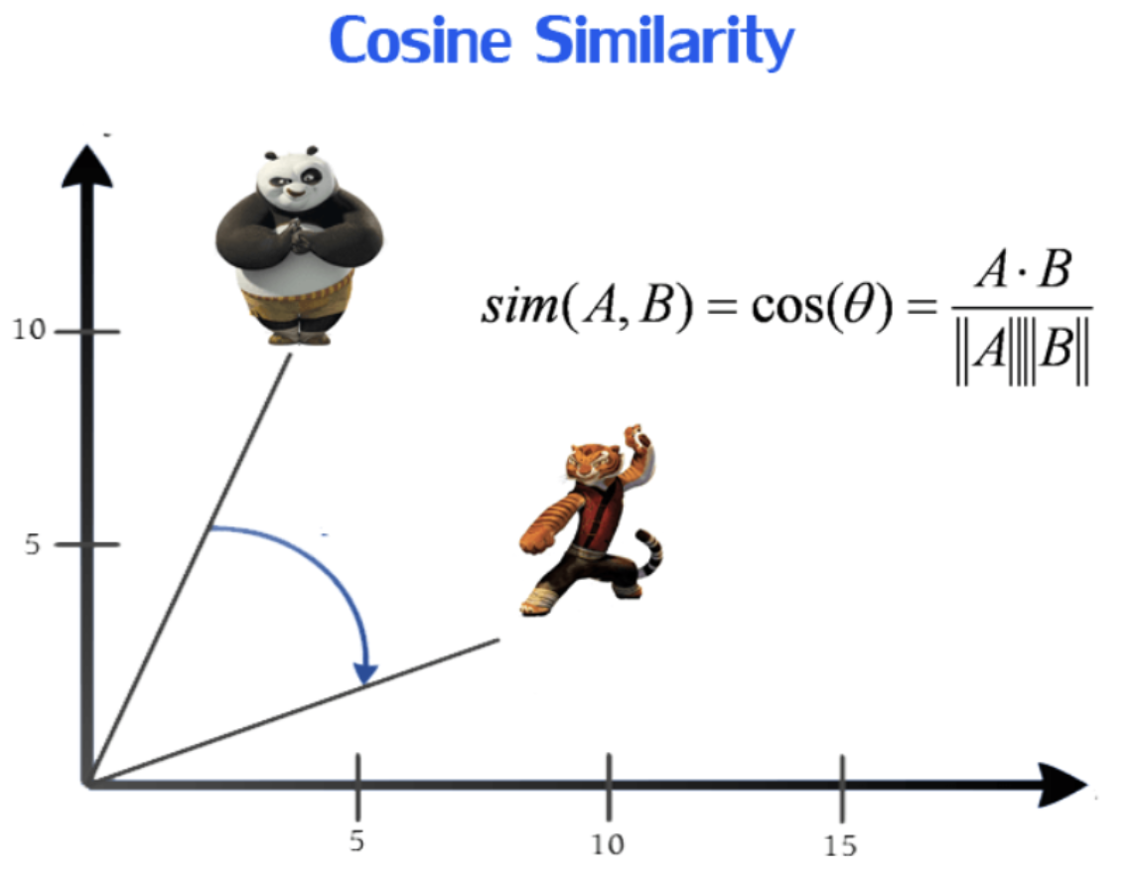
What is vector search?
We find similar concepts by comparing embedding vectors with each other.
If vectors are similar, concepts are similar.
Standard method for similarity search in RAGs is using cosine similarity.

Slide 21
Cosine Similarity
v = [ 2 1 1 1 1 0 0 0 0 ] A cat sleeps on a sofa.
u₁​ = [ 2 0 1 1 1 0 1 0 0 ] A dog sleeps on a sofa.
u₂​ = [ 0 0 0 0 0 0 1 1 1 ] Pizza is delicious.
Dot product
v ⋅ u₁​ = 2*2 + 1*0 + 1*1 + 1*1 + 1*1 + 0*0 + 0*1 + 0*0 + 0*0 = 4 + 0 + 1 + 1 + 1 + 0 + 0 + 0 = 7 | v ⋅ u₂​ = 2*0 + 1*0 + 1*0 + 1*0 + 1*0 + 0*0 + 0*1 + 0*1 + 0*1 = 0 + 0 + 0 + 0 + 0 + 0 + 0 + 0 = 0
Vector norms
|| v || = √( 2²+1²+1²+1²+1²+ +0²+0²+0²+0²) = √(4+1+1+1+1) = √8 | || u₁ || = √( 2²+0²+1²+1²+ +1²+0²+1²+0²+0²) = √(4+1+1+1+1) = √8 | || u₂ || = √( 0²+0²+0²+0²+ +0²+0²+1²+1²+1²) = √(1+1+1) = √3

Slide 22
And the winner is…
sim (v, u₁​) | sim (v, u₂​)
cos(θ) = v ⋅ u₁​ || v ||*|| u₁​ || cos(θ) = 7 √8*√8 cos(θ) = 7/8 = 0.875 Angle θ ≈ cos^{⁡−1}(0.875) ≈ 30∘ | cos(θ) = v ⋅ u₂​ || v ||*|| u₂ || cos(θ) = 0 √8*√3 cos(θ) = 0/√24 = 0 Angle θ ≈ cos^{⁡−1}(0) = 90∘

Slide 23
In RAG:
User asks a question.
We embed the question.
We compare it to stored chunk embeddings.
We retrieve the most similar chunks.

Slide 24
Embedding models
Embedding models differ in:
• Vector dimension (384, 768, 1024, 1536…)
• Training data
• Training objective
• Multilingual capability
• Domain specialization
• Speed
• Cost
• Open-source vs API
Lots and lots of models
Hugging Face leaderboard
MTEB (Massive Text Embedding Benchmark)
https://huggingface.co/spaces/mteb/leaderboard
An embedding model is used
only for embeddings.
It is not a chat model.
It does not generate text.
It only produces vectors.

Slide 25
Embedded bias
Embedding models inherit:
Cultural biases
Training data patterns
Political skew
Domain skew
So even before the LLM answers anything,
bias may already be encoded in e.g. what chunks get retrieved.
Bias can enter:
During embedding
During retrieval
During generation
Hallucinating LLMs is not the only problem. Bias is also a problem.

Slide 26
Create prompts with context

Slide 27
Building prompts with context
System instructions
Guardrails
How much context do we need? What is Top-K?

Slide 28
System Instructions
System instructions are critical in RAG.
Without system instructions:
The model may hallucinate.
It may ignore retrieved documents.
It may use prior knowledge.
LLMs are obedient (unless you hit guardrails).
The role of the model
The constraints
The behavior
The source of truth

Slide 29
Guardrails
Designed to prevent:
Harmful outputs
Misinformation presented as fact
Unsafe instructions
Policy violations
Manipulation or abuse
Guardrails do NOT:
Remove all bias
Guarantee factual accuracy
Eliminate hallucinations
Guardrails are safety mechanisms that constrain model behavior.
In a RAG a model must balance:
Obedience to instructions
Internal safety training
Guardrails in action:
https://gandalf.lakera.ai/baseline

Slide 30
How Much Context Do We Need?
Too little context:
Missing important information.
Incomplete answers.
Too much context:
Increased cost.
Noise.
Confusion.
Diluted signal.
Lower retrieval precision.
More context ≠ better answers.
If you overload it with loosely related chunks, you reduce clarity.

Slide 31
What Is Top-K?
Low K:
More focused
Less noise
– Risk of missing key info
High K:
More coverage
– More noise
– Higher token cost
– More cognitive load on model
In practice:
K = 3–5 is common for small chunks.
Larger corpora may use reranking after initial retrieval.
The number of most similar chunks that are retrieved during vector search.

Slide 32
Talk to LLMs

Slide 33
Talk to LLMs
Temperature
Top-P
Max tokens

Slide 34
Temperature
Low temperature (0.0–0.3)
Deterministic
Focused
Reproducible
Medium (0.4–0.7)
Balanced
Slight variation
High (0.8–1.2+)
Creative, diverse
Less predictable
Higher hallucination risk
Temperature controls randomness.
Low temperature:
The most likely token almost always wins.
High temperature:
Less likely tokens get a chance.
Can’t be adjusted in reasoning models!

Slide 35
Top-P
From Gemini documentation:
Tokens are selected from the most probable to least probable until the sum of their probabilities equals the top-P value. For example, if tokens A, B, and C have a probability of 0.3, 0.2, and 0.1 and the top-P value is 0.5, then the model will select either A or B as the next token by using temperature and excludes C as a candidate.
The cumulative probability mass considered for token selection.
Lower value for less random responses and a higher value for more random responses.

Slide 36
Temperature reshapes how confident the model is.
Top-p limits how many candidate tokens are considered.

Slide 37
Max tokens
Prevents runaway responses
Controls cost
Prevents exceeding context window
Total context window =
Input tokens + Output tokens
This parameter limits how long the model’s response can be
(output tokens).

Slide 38
Let’s improvise

